Slide 1

Universal Remote Controller
And ATV Project
By: Joshua Makuch, Zachary Christensen and Baden Brenner
Notes:
Zac

Slide 2
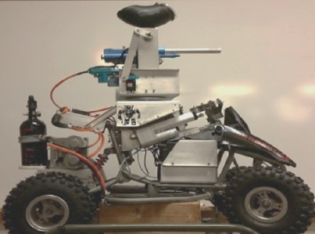
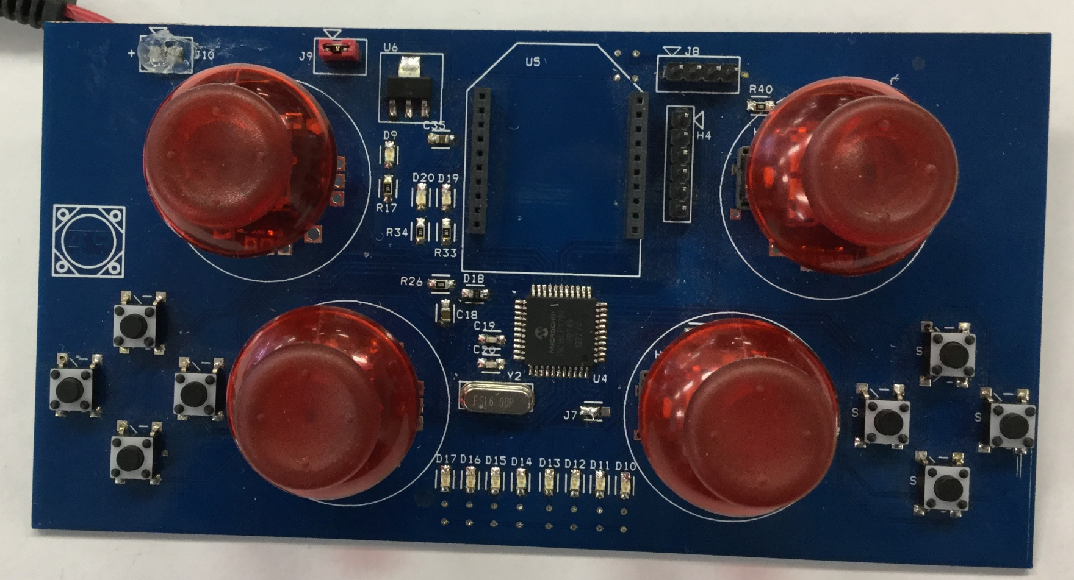
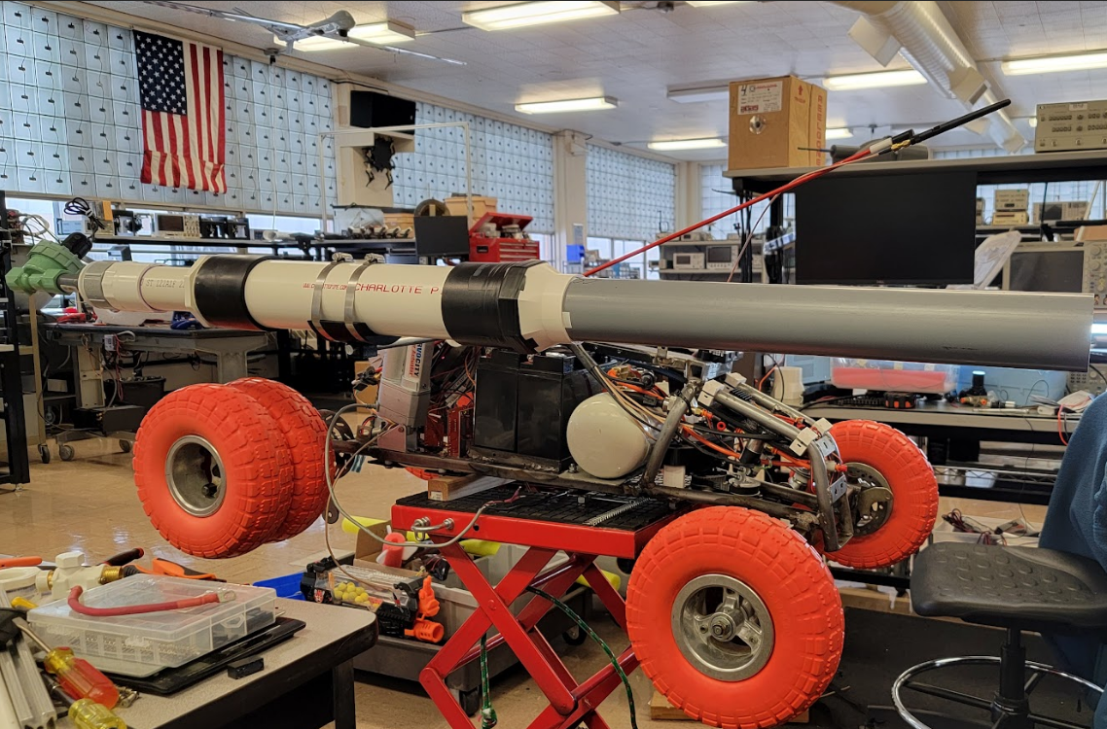
Background
Originally started in 2014, the mini ATV is now on the fifth iteration. (Right)
Originally started in 2014, the URC is now on the third iteration. (Bottom)
Notes:
Josh

Slide 3
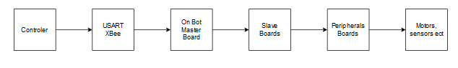
What's The Goal?
Begin development on a Universal Control System (UCS).
Design PCBs for various parts of the UCS.
Design a shell for the URC.
Design two peripheral devices for the URC.
Redesign the turret mechanisms for the mini ATV and Full ATV
Notes:
Baden

Slide 4
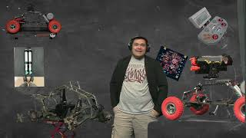
Universal Control System (UCS)
Notes:
Josh

Slide 5
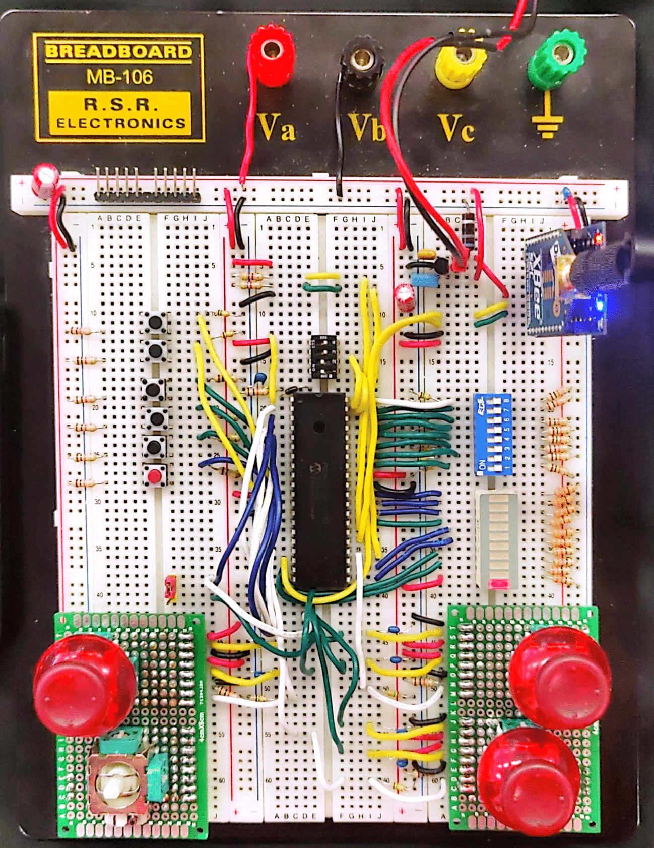
URC Breadboard
- Nearly identical design from 2023.
- Updated POR circuit makes the URC turn on ~100mS after power on.
- I^2C now uses the VCC rail.
- Now capable of multi-byte, two-way I^2C communication.
Notes:
Josh

Slide 6
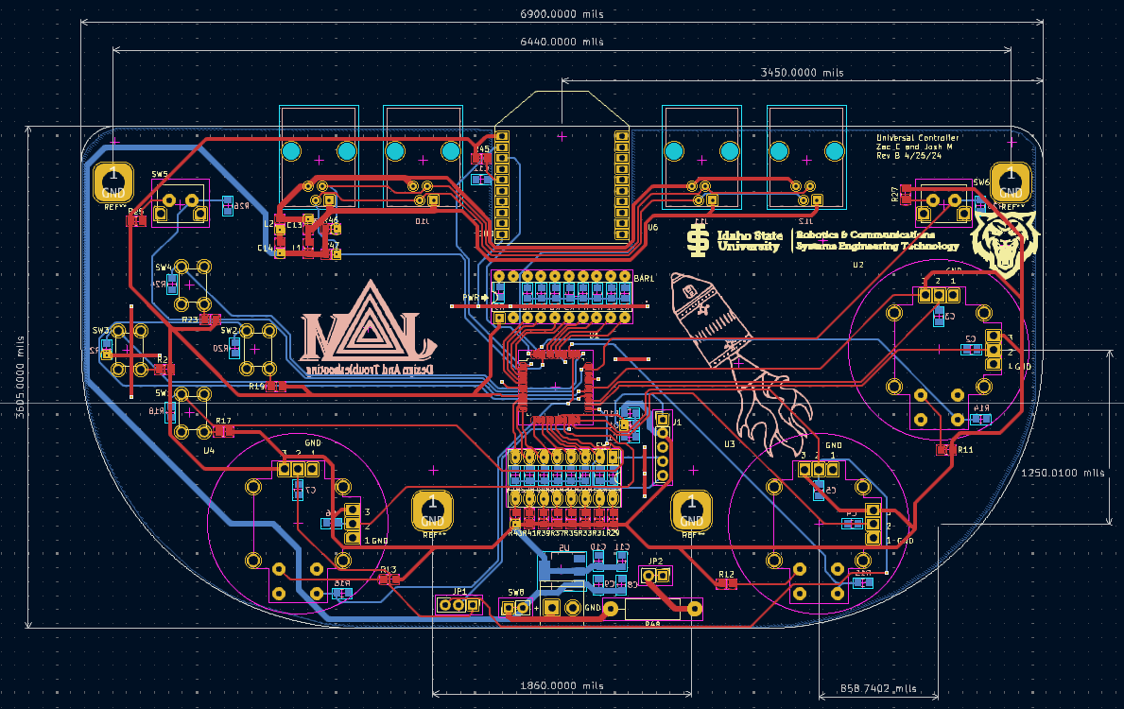
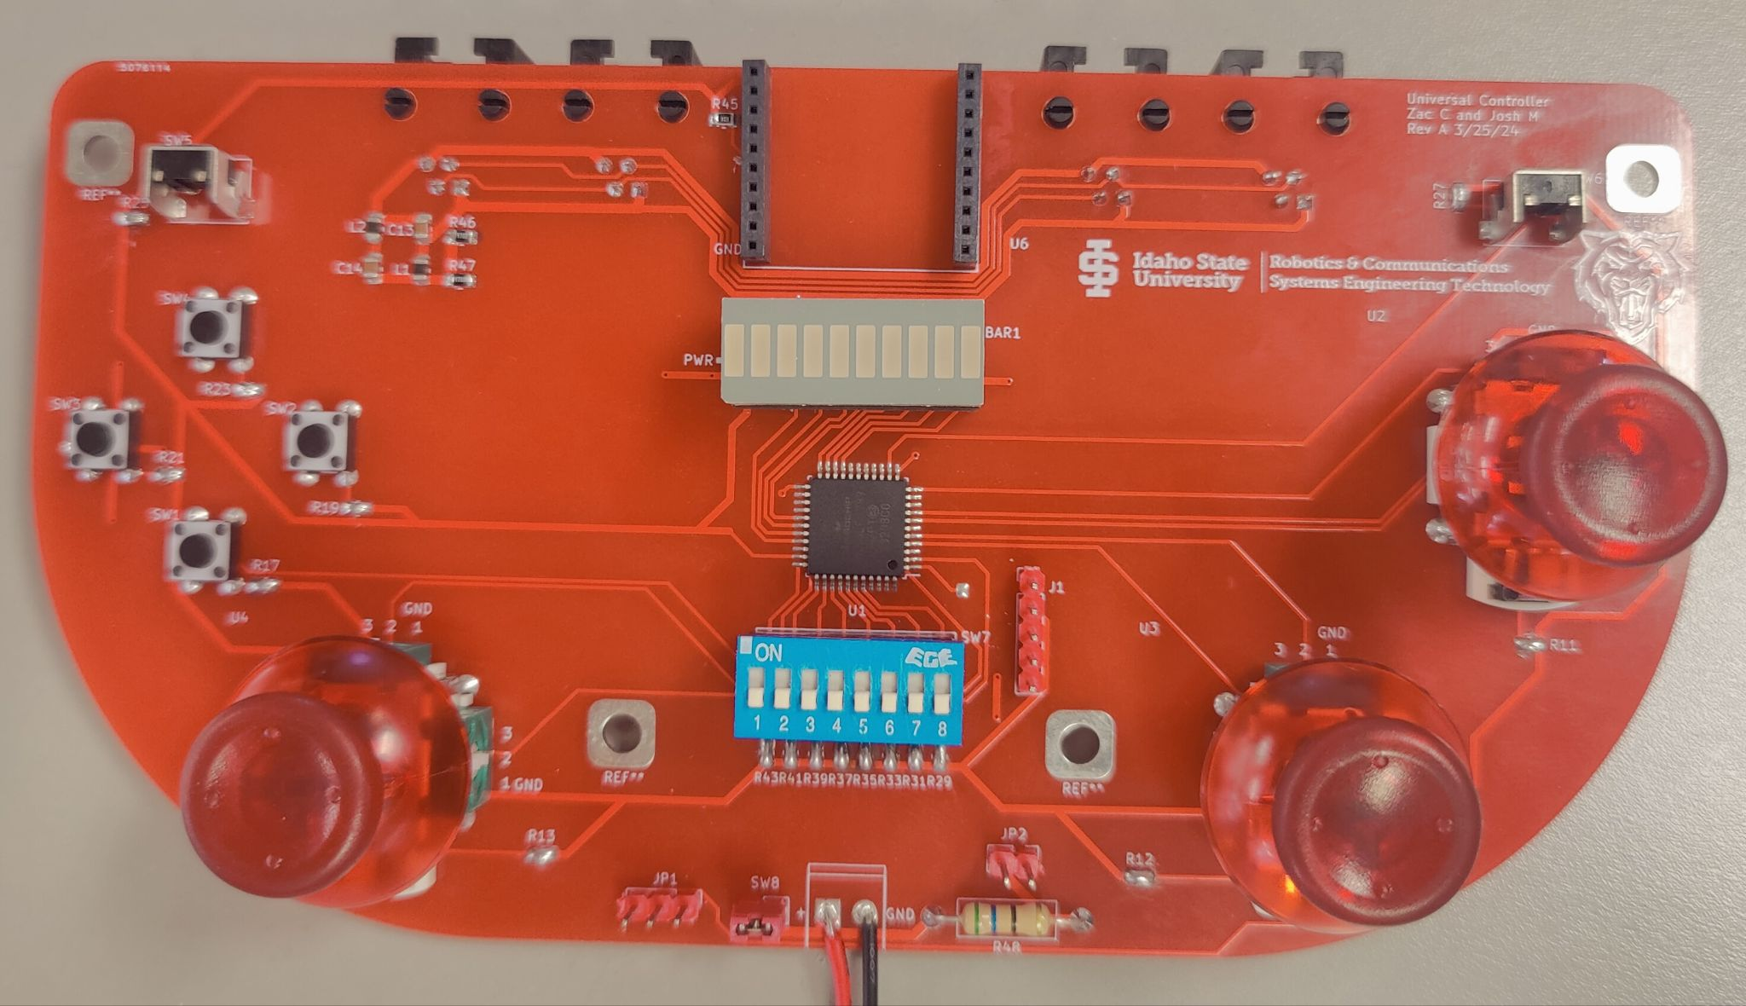
URC PCB
- Based off of the 2023 proposed controller layout.
-I^2C ports designed to connect with RJ9 cables
-Three distinct trace widths: 40 mils (2.42A), 30 mils (1.96A), and 15 mils (1.18A)
Notes:
Zach

Slide 7
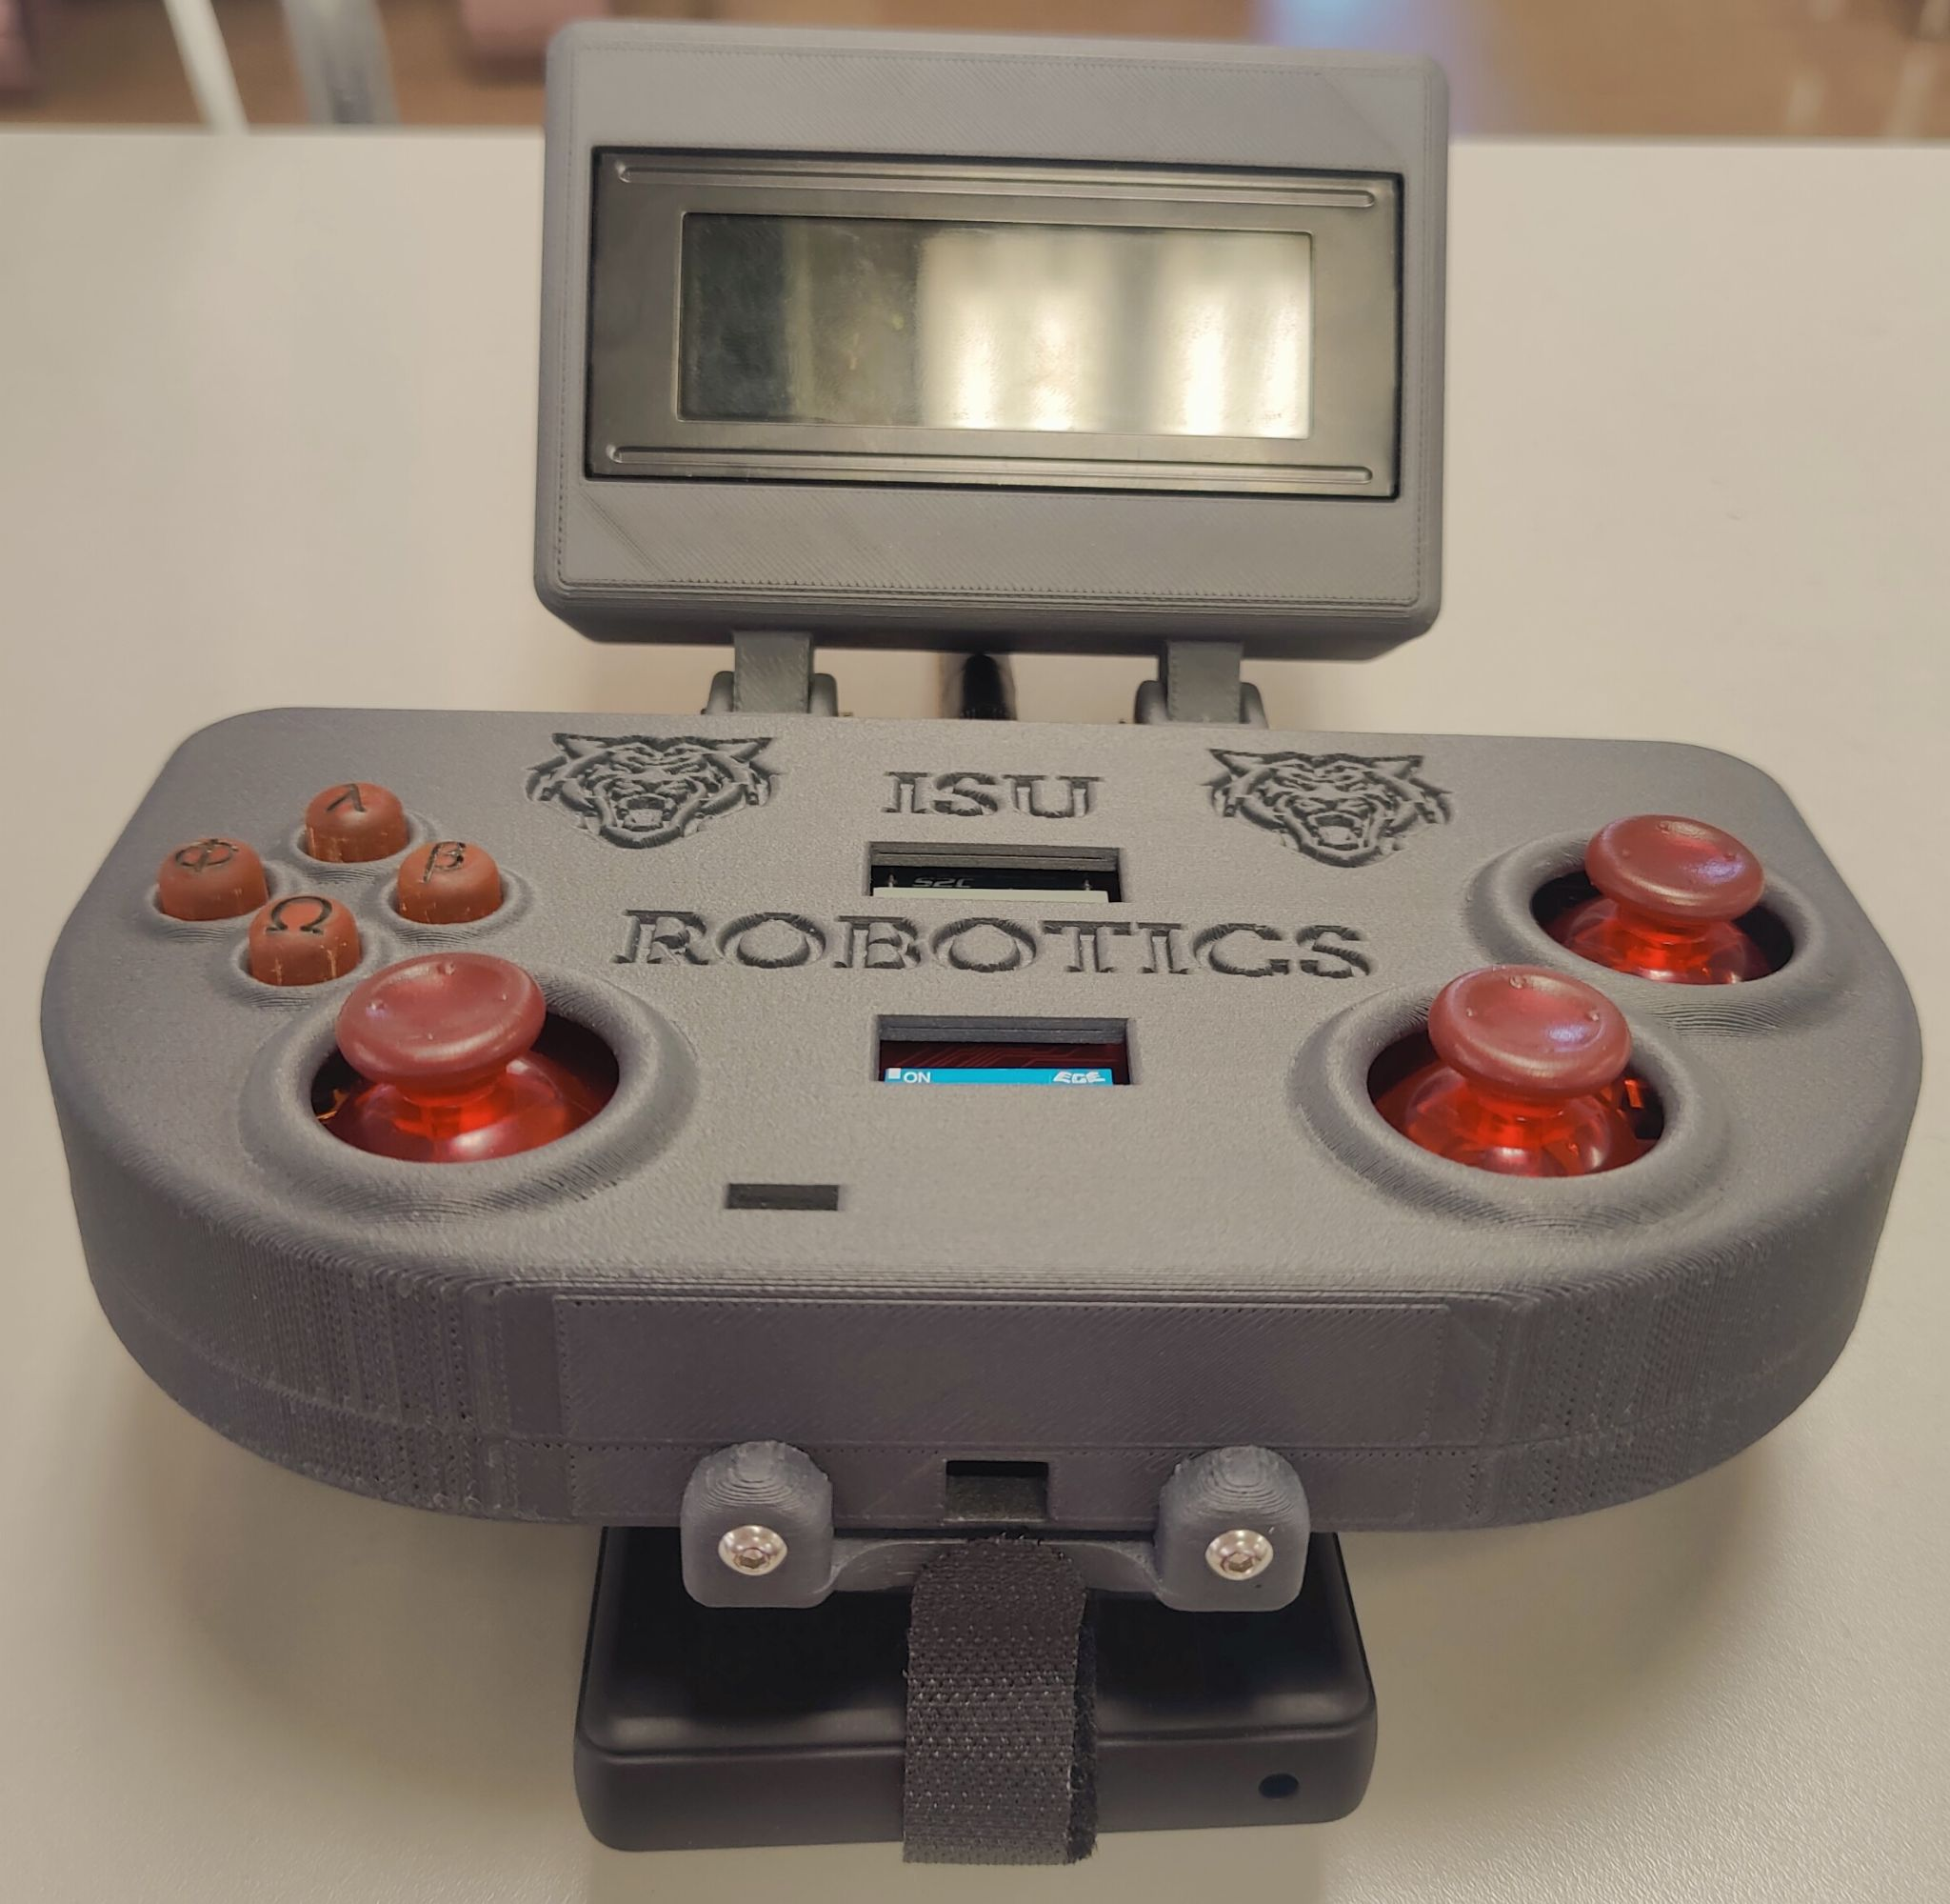
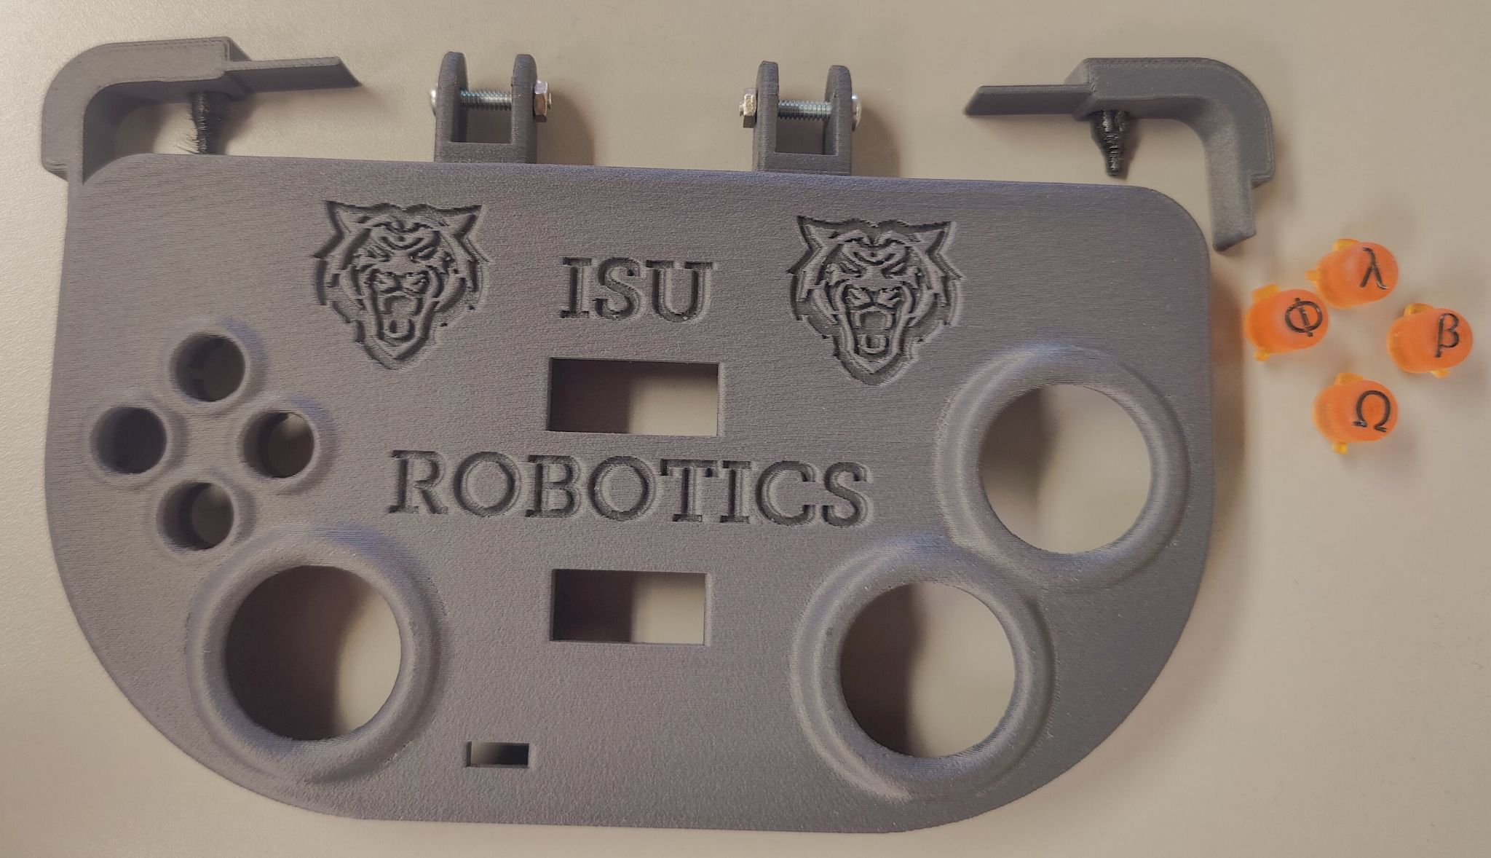
URC Shell
-Case designed around the PCB
-Custom Buttons
-Modular Peripherals and Batteries
Notes:
Zach

Slide 8
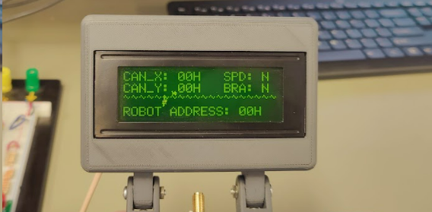
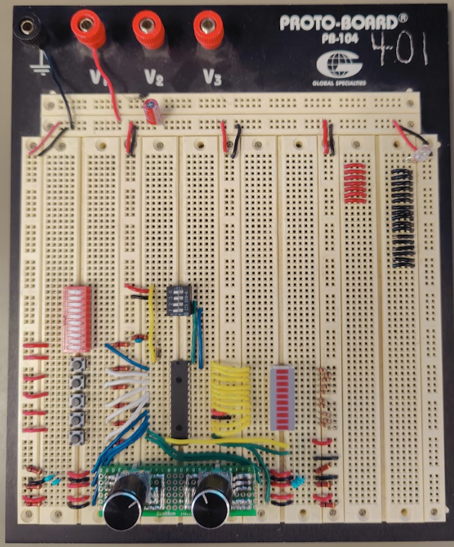
Peripheral Devices
A peripheral display (top).
A peripheral controller (right).
Set to peripheral addresses 8 and 50.
Notes:
Josh

Slide 9
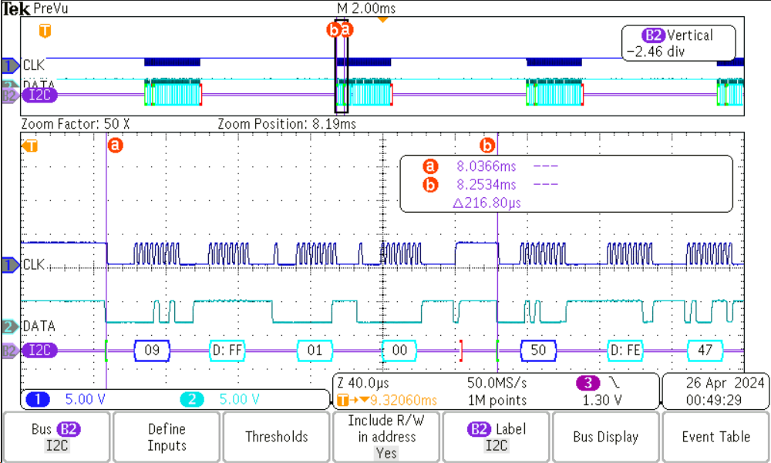
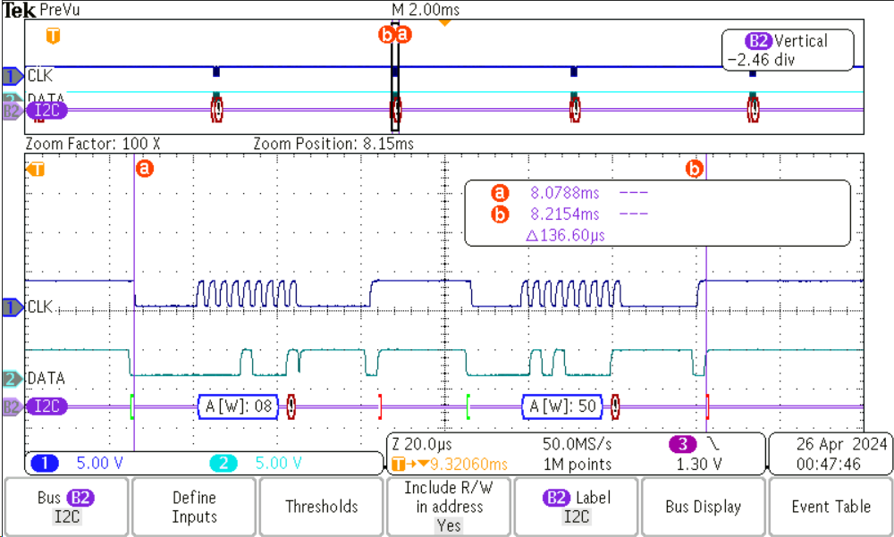
I^2C Communications
400 kHz clock.
Peripheral identification and communication.
Loss of connection.
Notes:
Josh

Slide 10
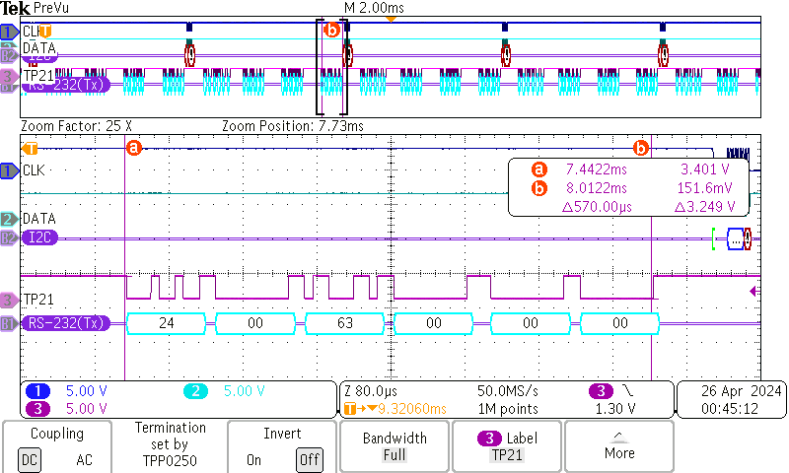
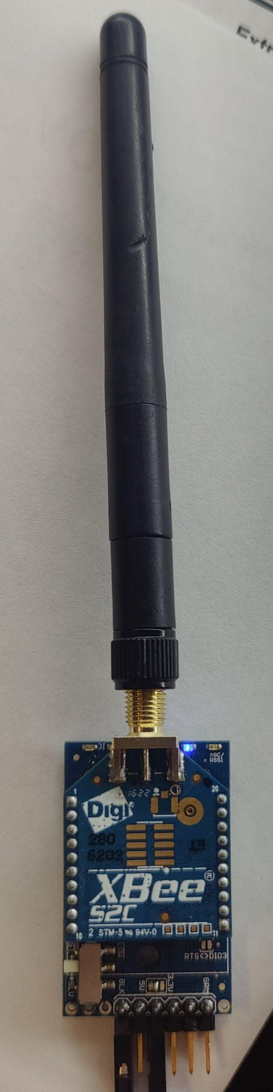
UART Communications
UART communication established at 115200 baud.
560 uS spacing between packets. Down from 6mS.
Wireless communication handled via XBee.
Notes:
Josh

Slide 11
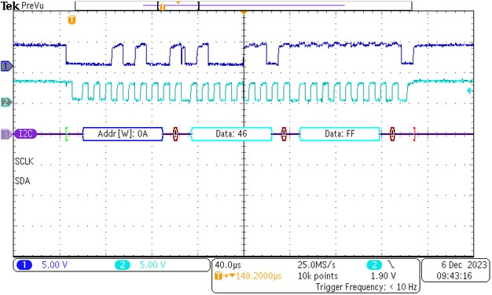
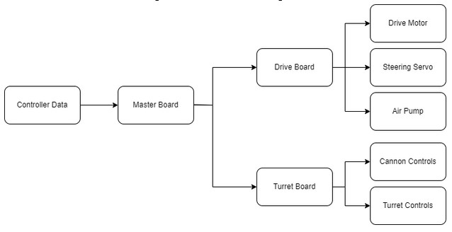
ON-Bot I^2C
Notes:
Baden

Slide 12
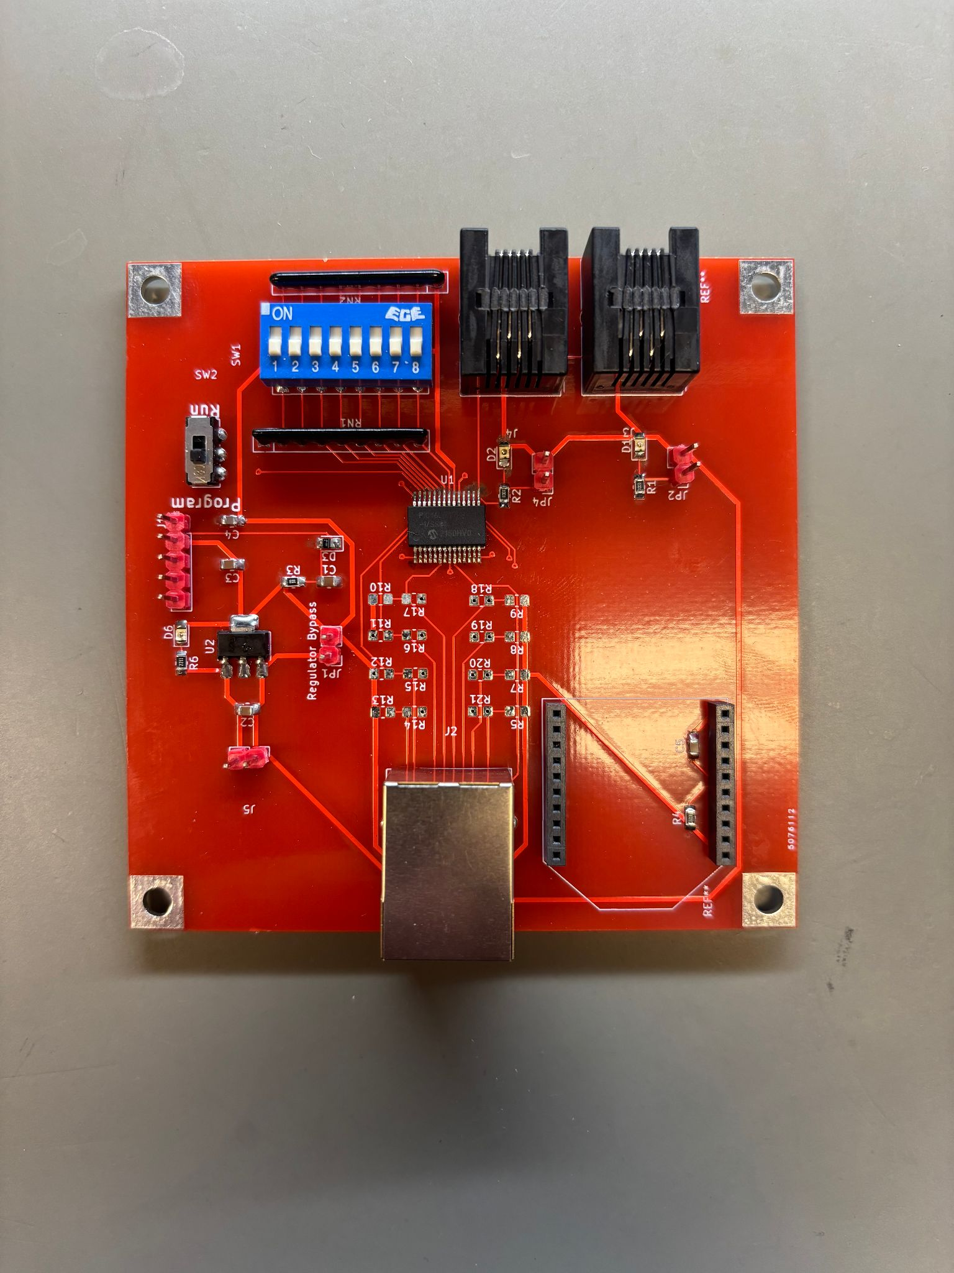
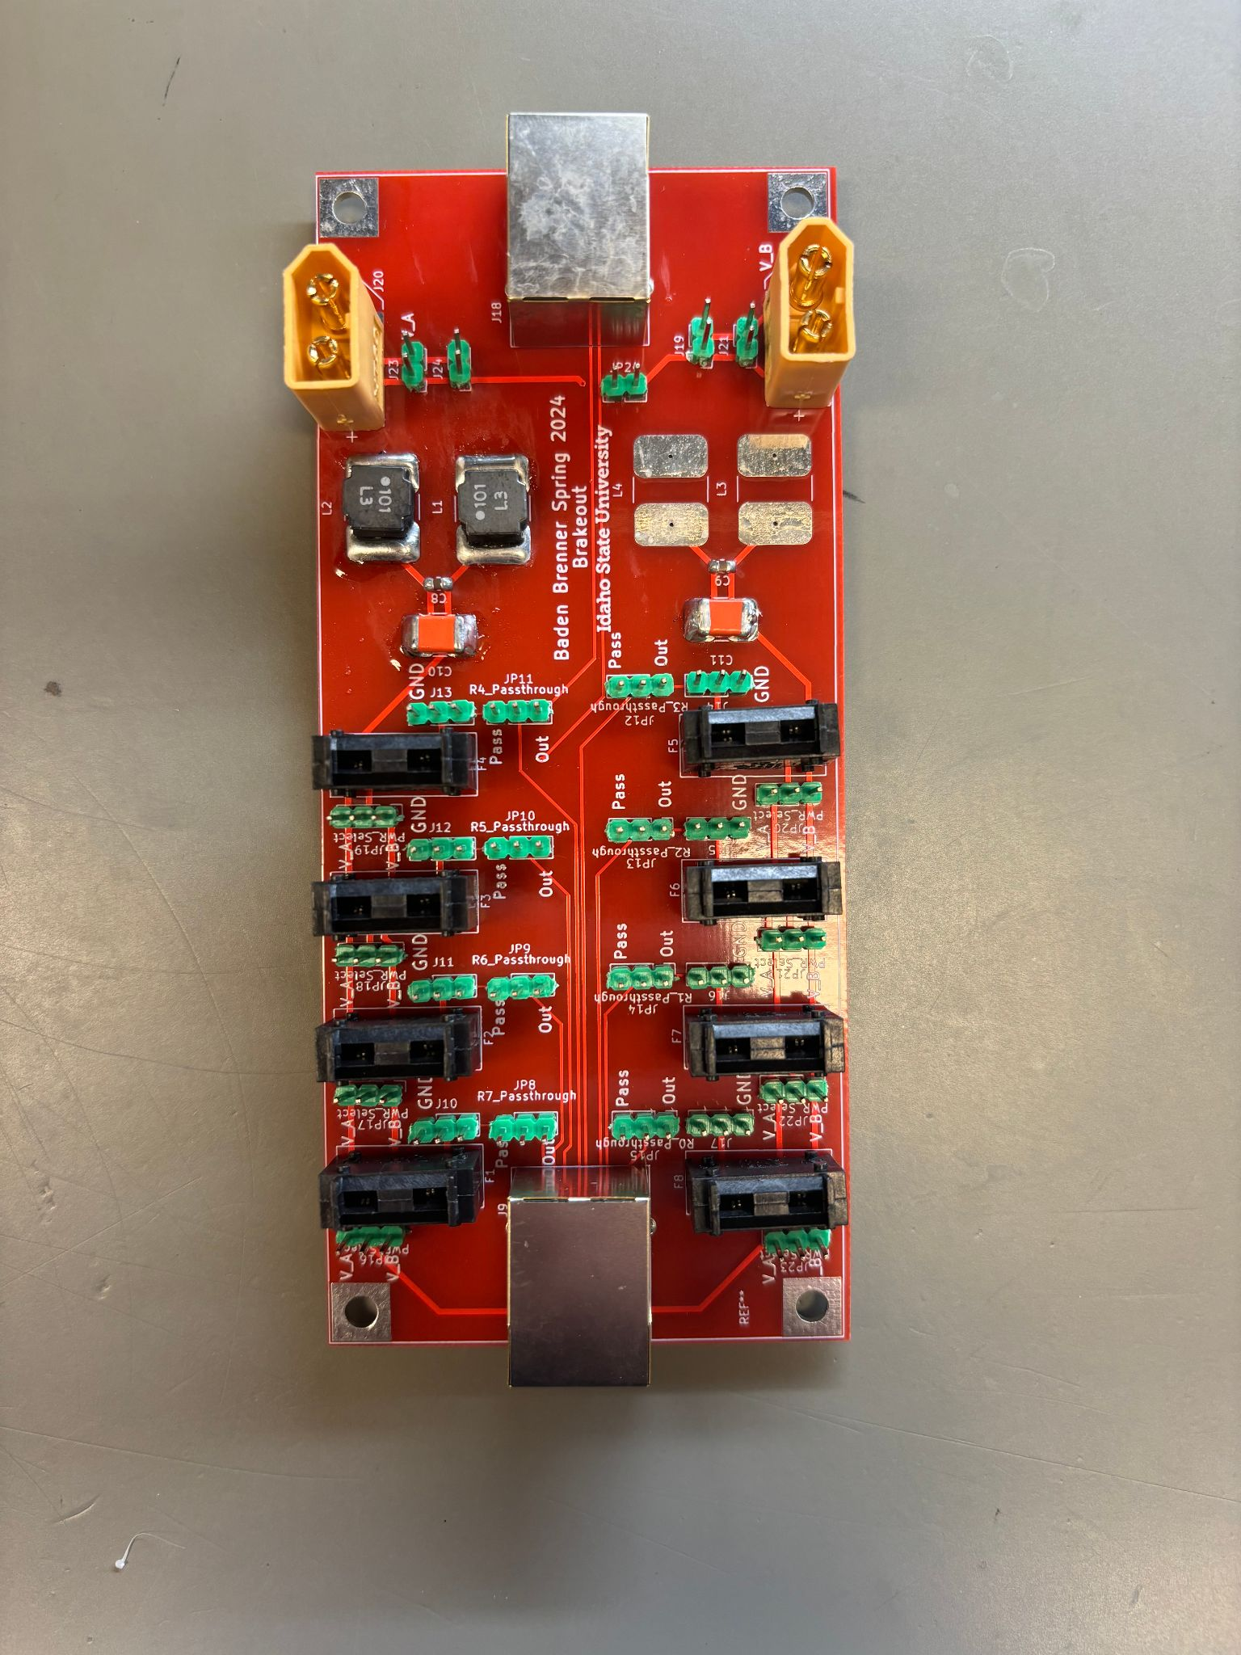
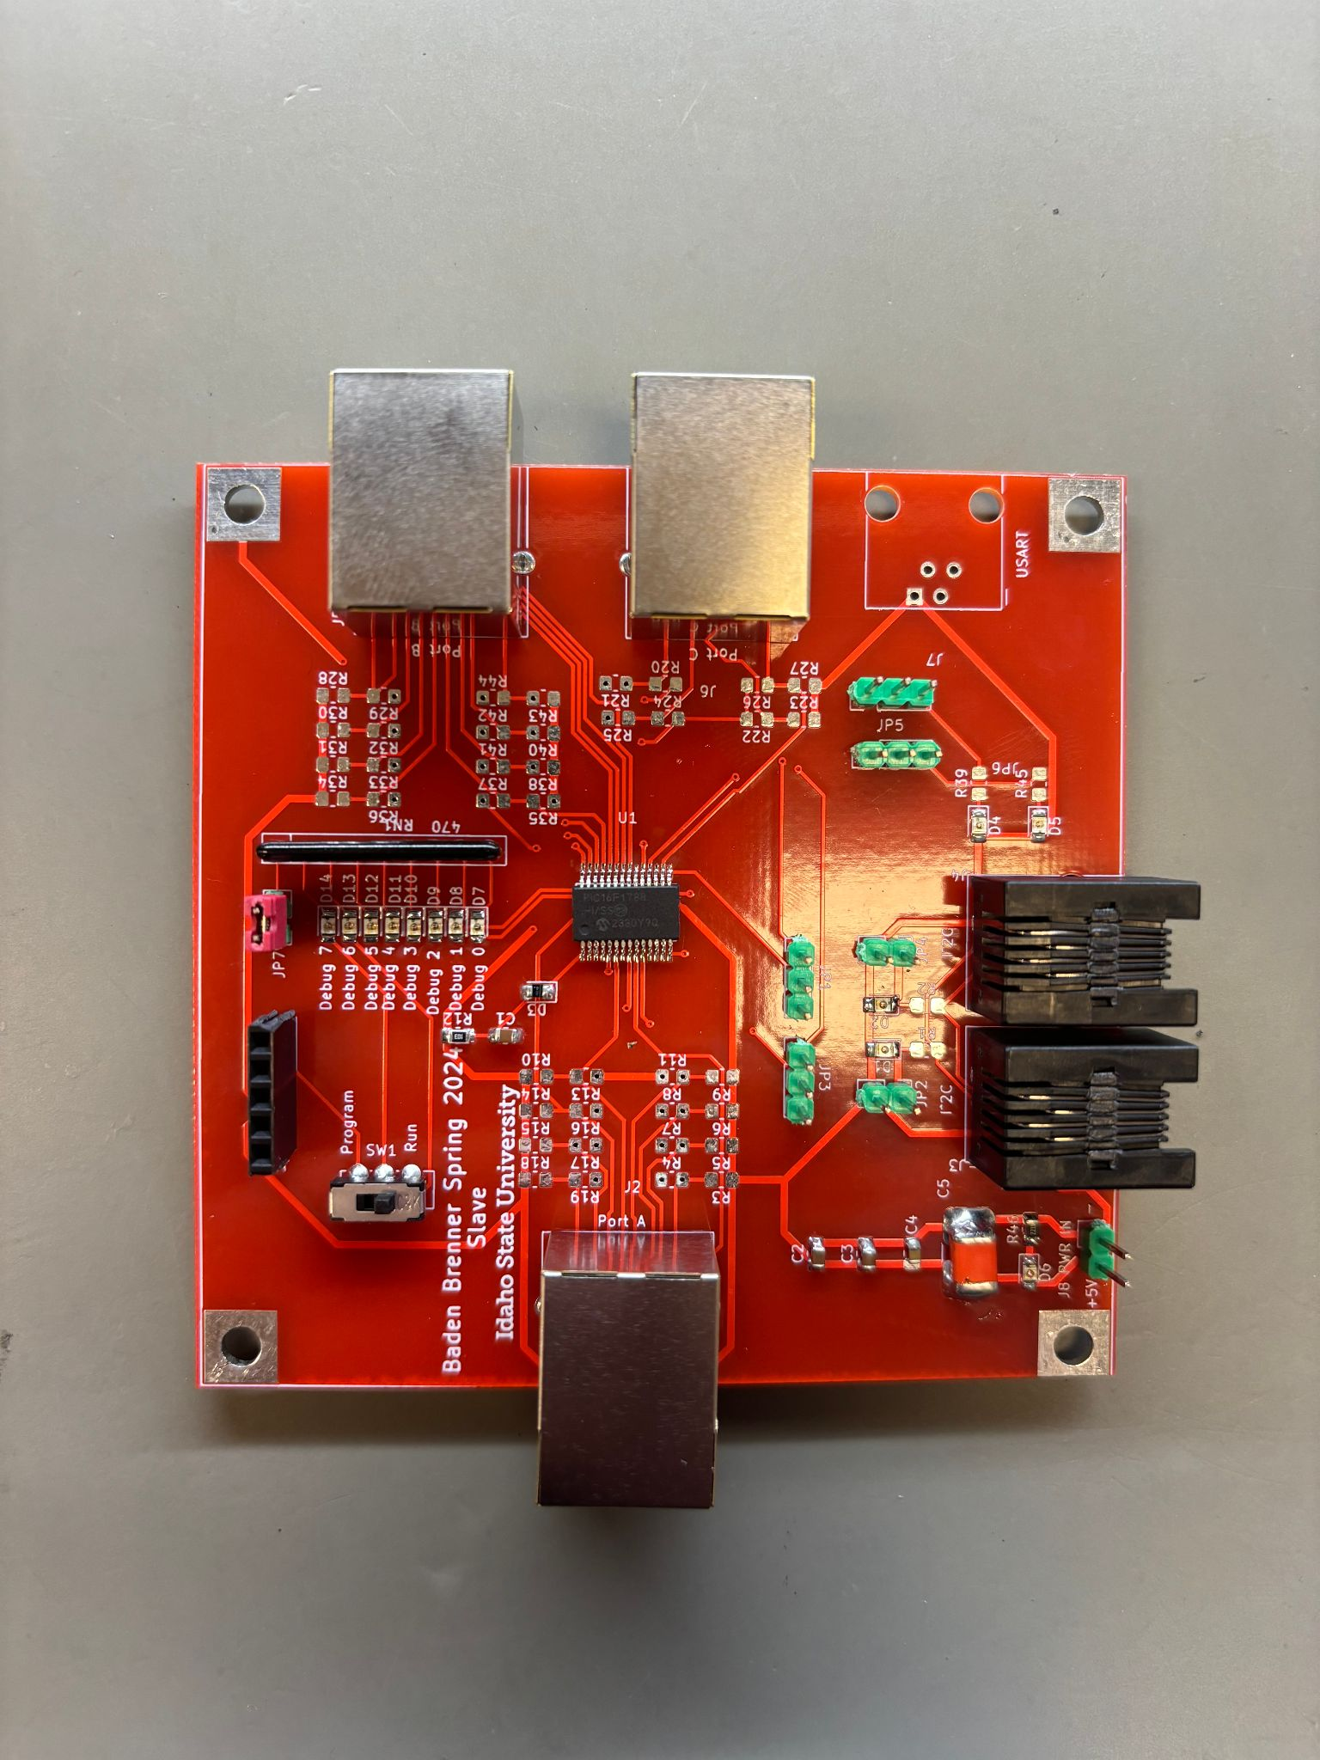
On-Bot Hardware - UCS
-Connected by RJ9 and RJ45
-Designed to be modular
Notes:
Baden

Slide 13
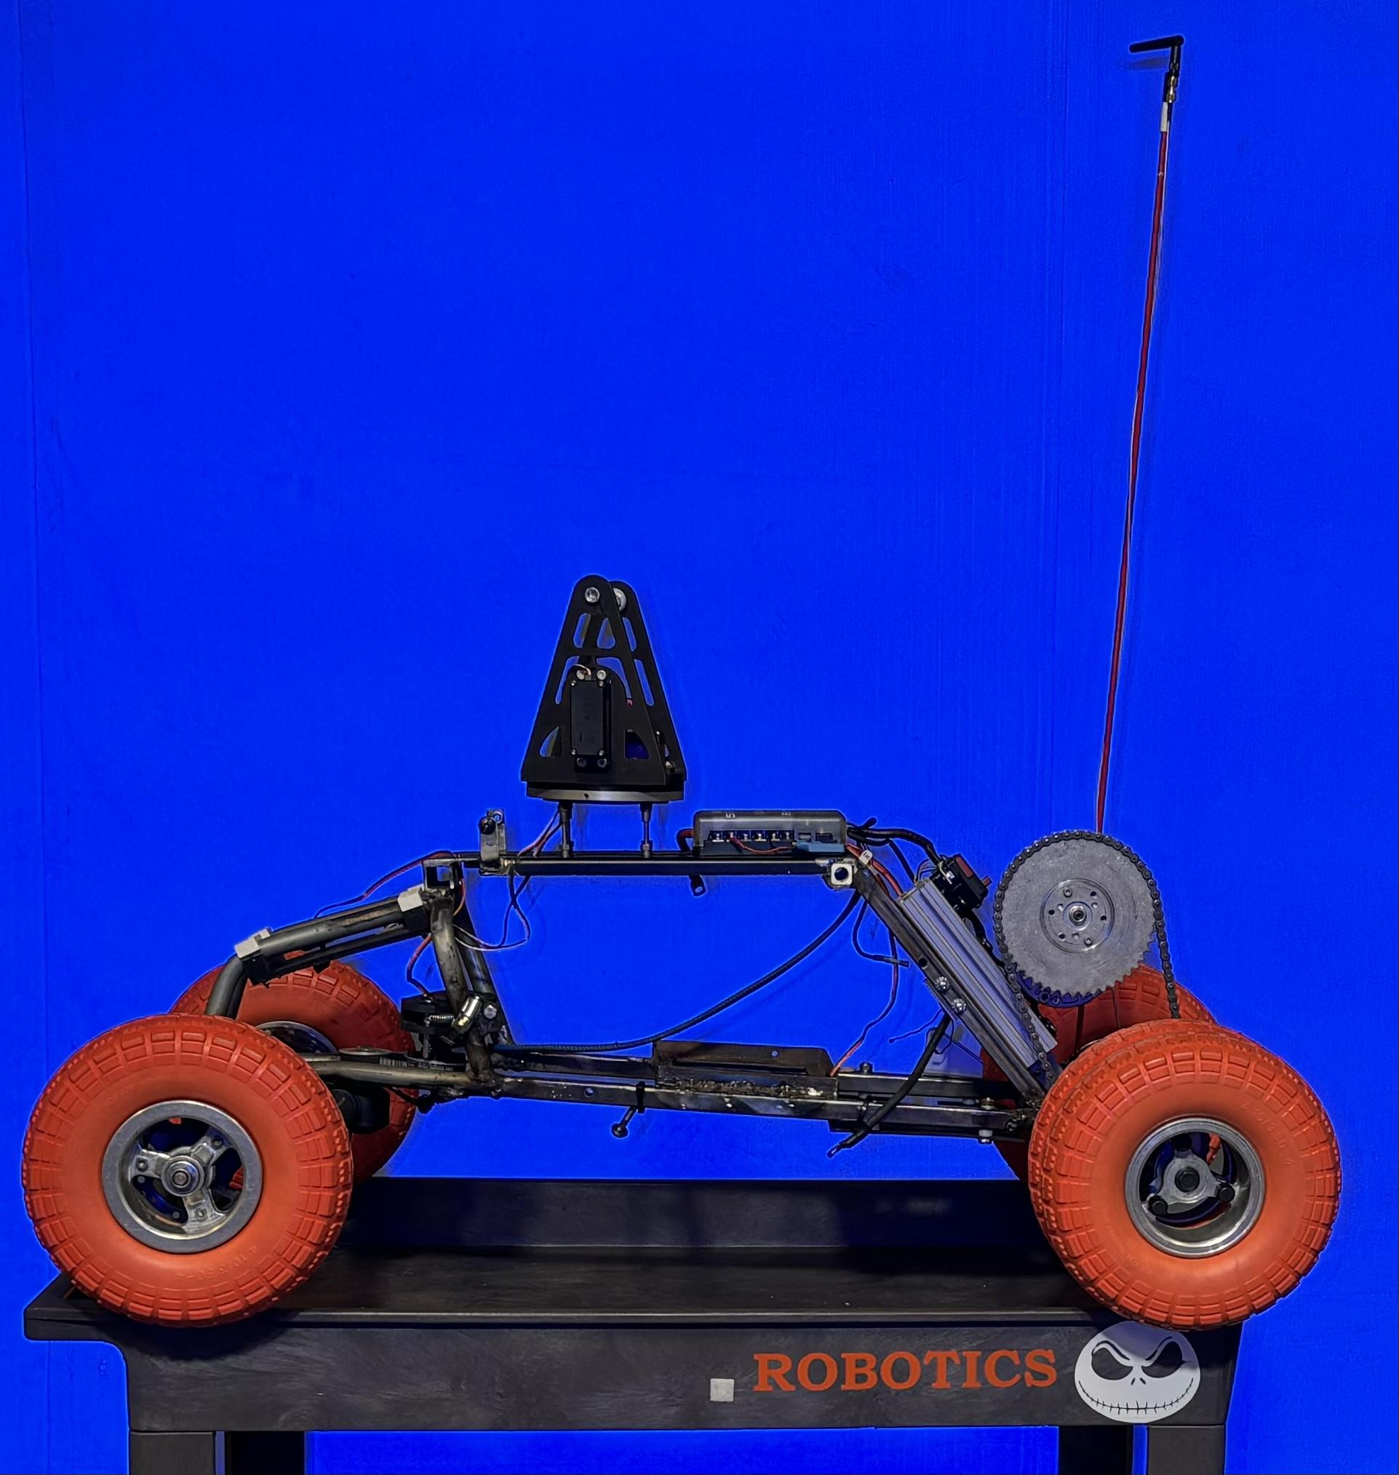
Mini ATV
-Repair the antenna
-Improve the mounting clamps
-Remove the air system
-Replace the air cannons with nerf
Notes:
Baden

Slide 14
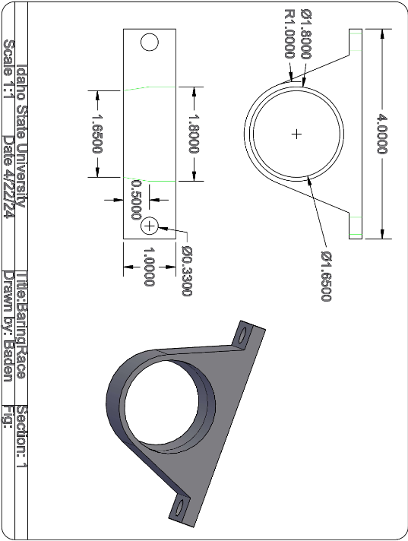
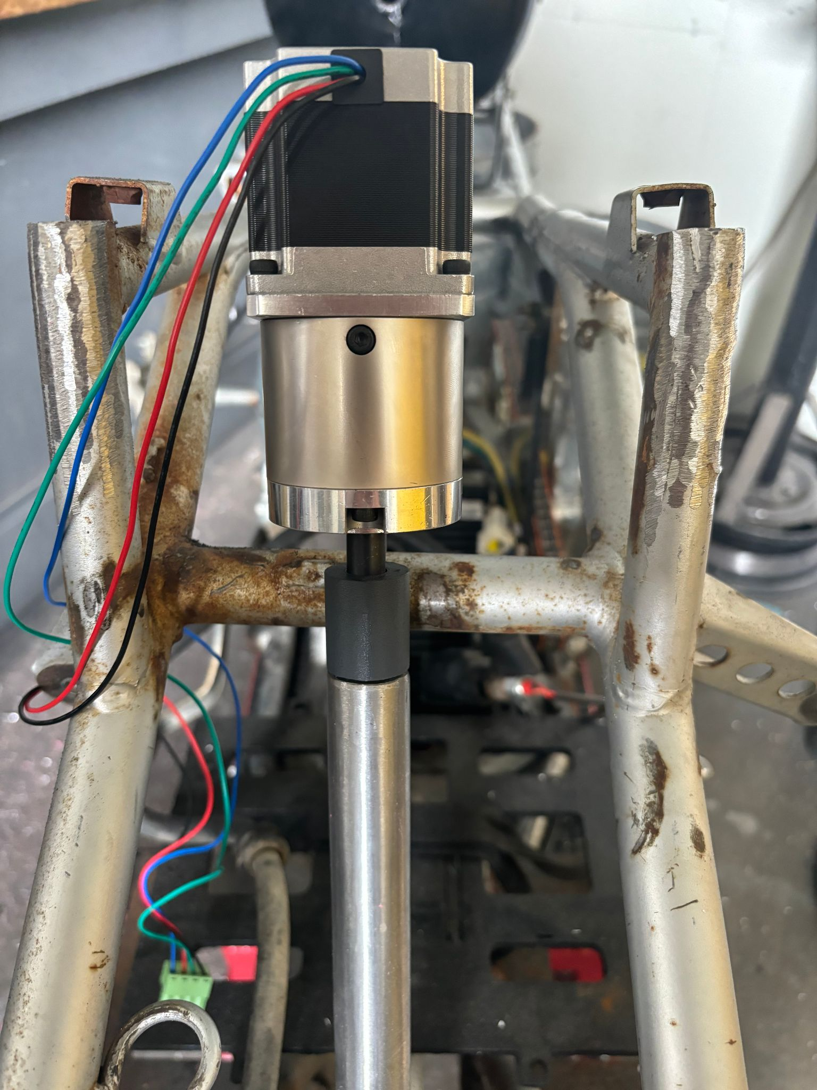
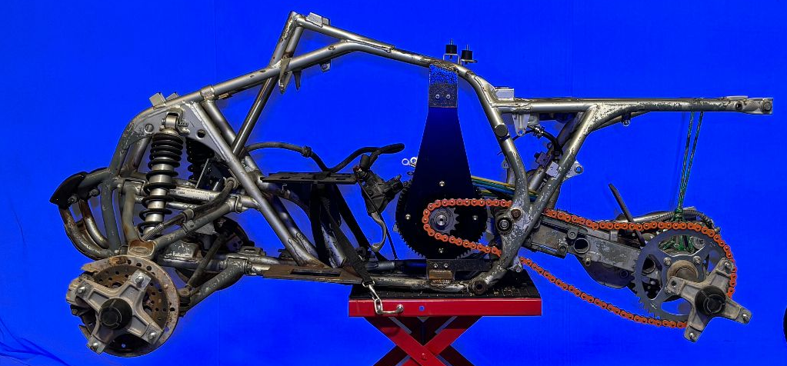
Full size ATV
-Air System
-Steering system
-Stepper Gearbox (150 in-lbs Max)
-Turret system
Notes:
Zac

Slide 15
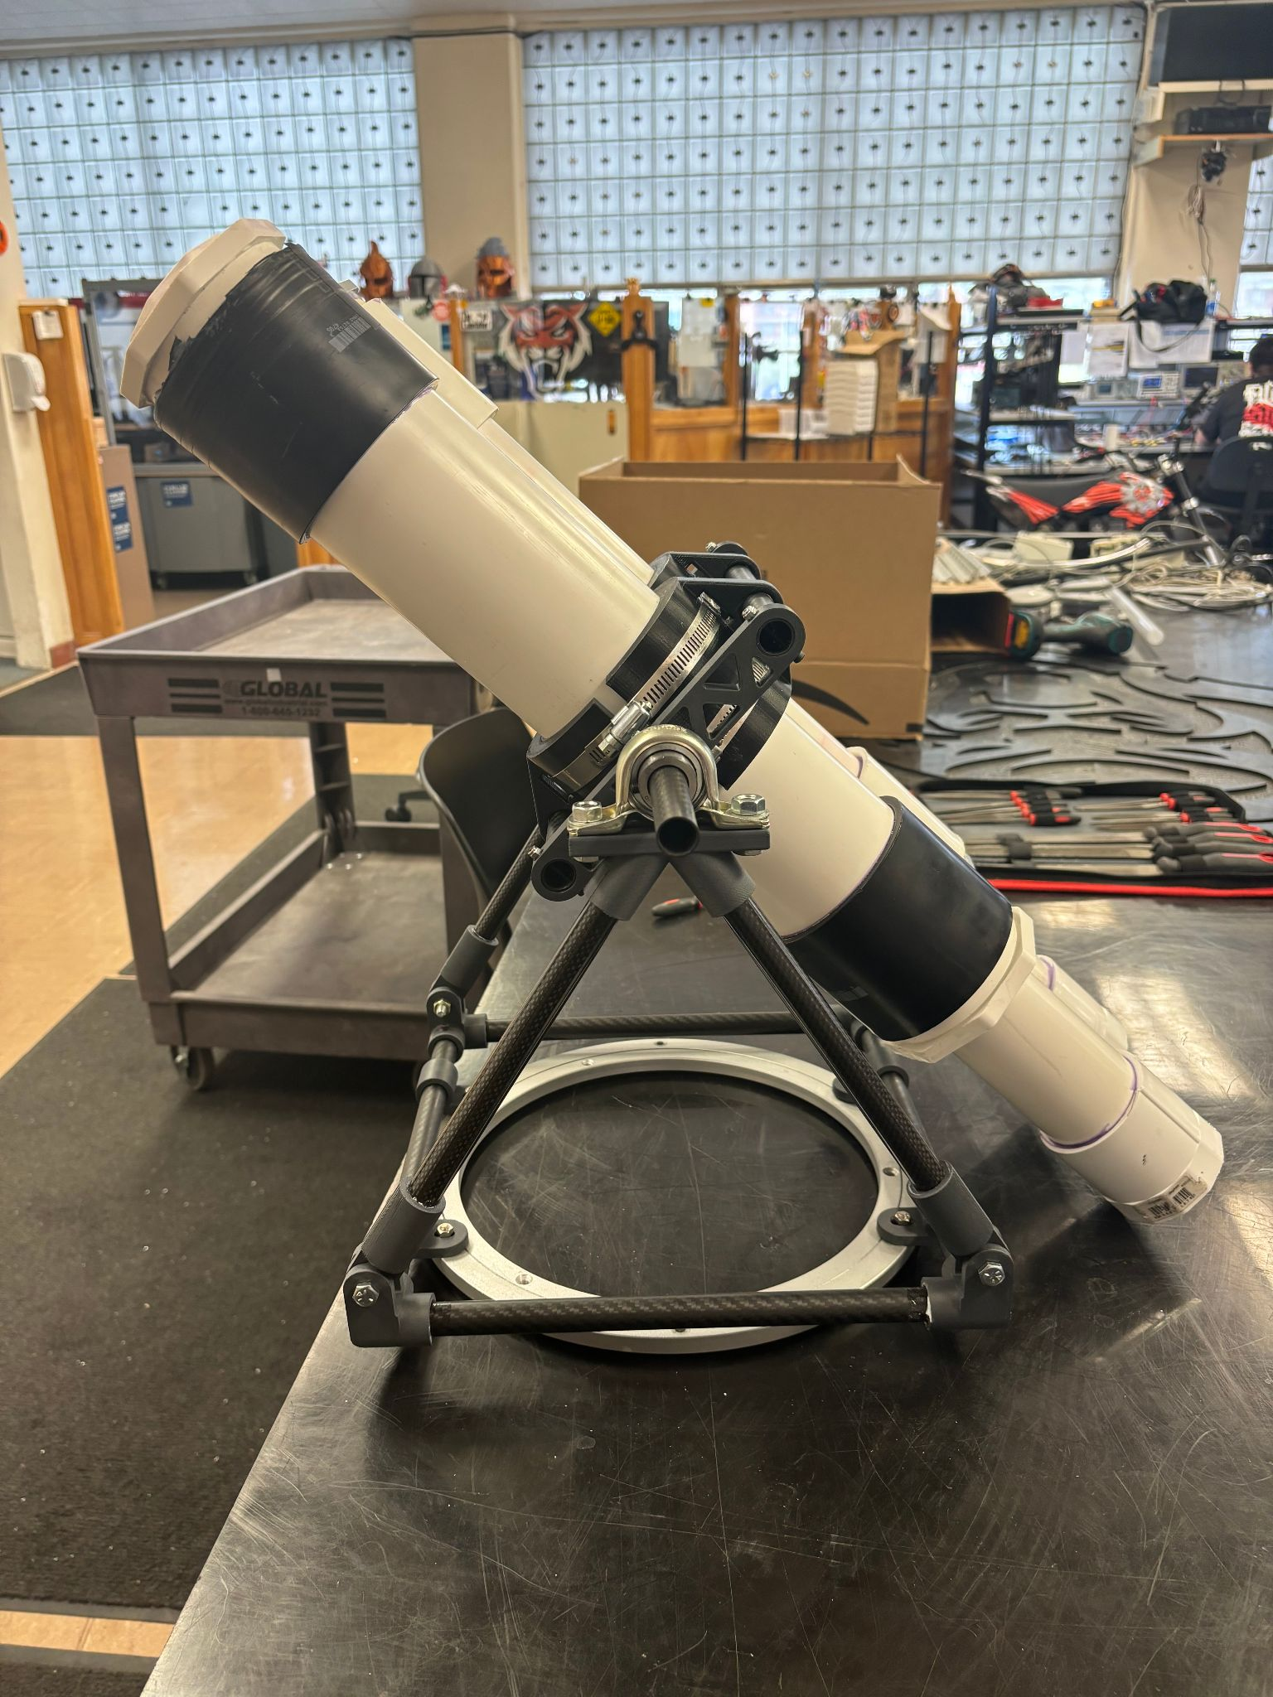
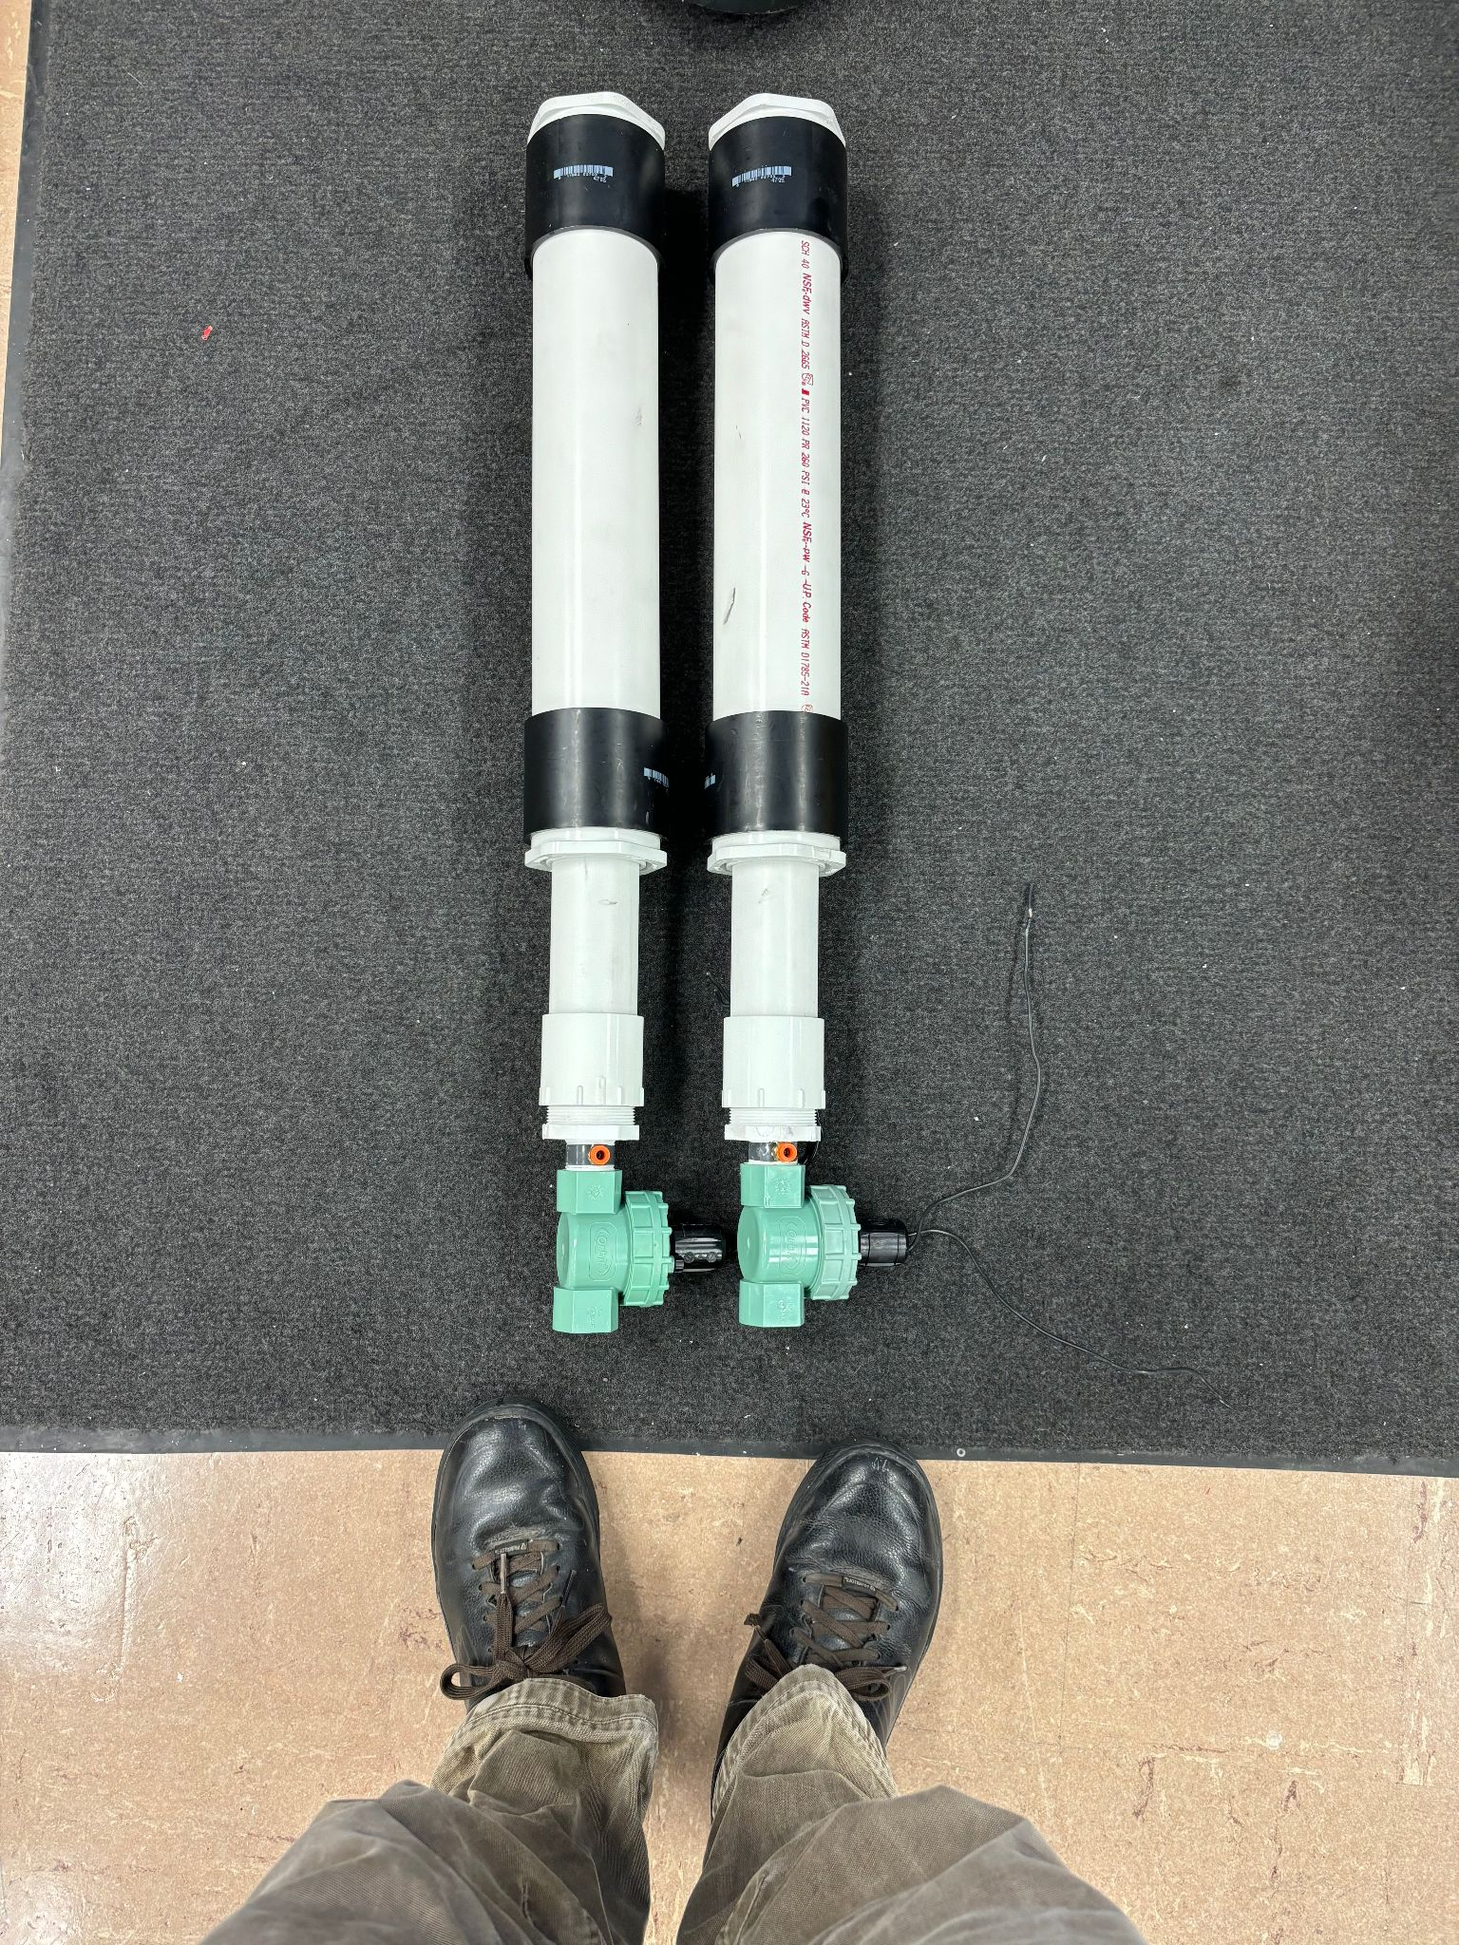
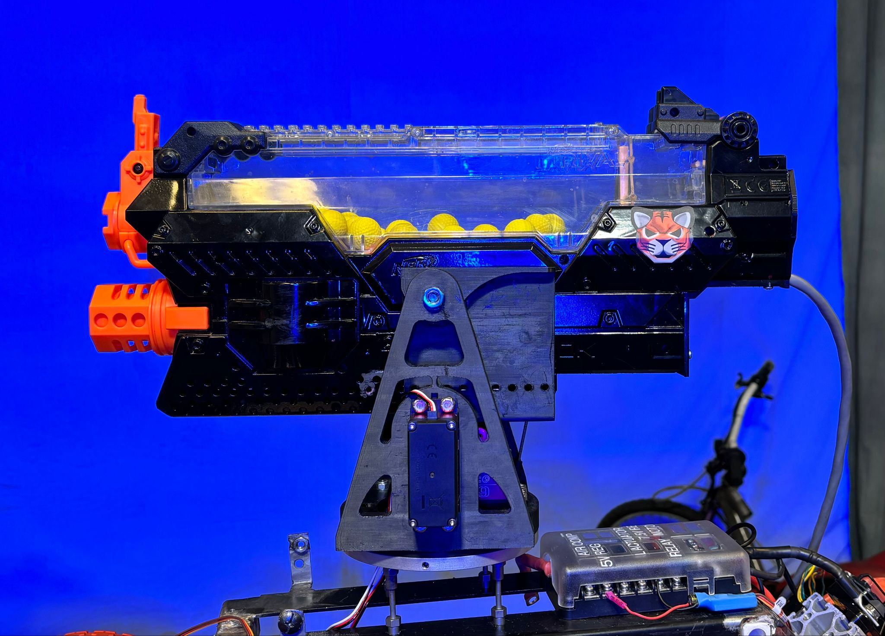
Turret Design
Notes:
Baden

Slide 16
Recommendations
- Finalize the steering system for full size ATV.
- Finalize the turret system for full size ATV.
- Connect the on-bot hardware for mini ATV.
- Finalize and test the dead man switch system.
- Test updated URC PCB designs.
- Add reverse polarity protection on the I^2C connectors.
-Create battery pack with charge and output regulation
Notes:
Zach

Slide 17
Cost
Category | Cost
Electronics | $557.93
Mechanical Components | $353.00
3D Printing | $292.17
Labor Baden Brenner | $5,800.00
Labor Joshua Makuch | $5,150.00
Labor Zachary Christensen | $5,075.00
Total | $17,228.10
Notes:
Zach

Slide 18
Questions?
Notes:
Anyone

